Slide 1
Company Reorganization
CA Aditi Ganu-Vaze

Slide 2
Introduction
Amalgamation
Amalgamation refers to two or more existing companies and carrying either identical business or related business combined together and formed a new company. During this process the existing companies are liquidated, and a new company is formed to take over their business.
Absorption
Absorption is a process of an existing company take over the business of another existing company. Usually, a big corporate body takes over the small corporate body.
External Reconstruction
An existing company go into liquidation and a new company is formed for the purpose of to business of the liquidating company.

Slide 3
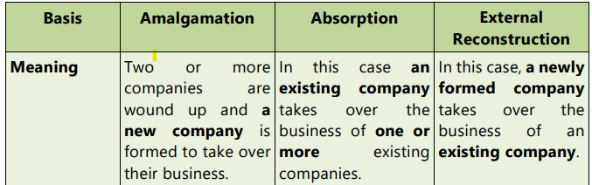
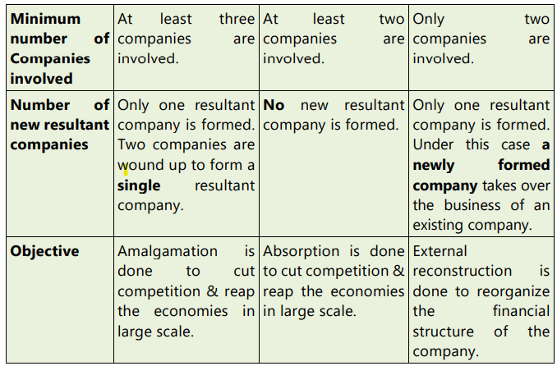
Comparison

Slide 4
Amalgamation in the Nature of Merger
All assets and liabilities of the transferor company, after amalgamation becomes the assets and liabilities of the transferee company.
Shareholders not less than 90% of the face value of equity shares of the transferor company (other than the equity shares already held therein, immediately before the amalgamation, by the transferee company or its subsidiaries or their nominees) become equity share holders of the transferee company by virtue of the amalgamation.
The consideration for the amalgamation receivable by those equity shareholders of the transferor company who agree to become equity shareholders of the transferee company is discharged by the transferee company wholly by the issue of equity shares in the transferee company, except that cash may be paid in respect of any fractional shares.

Slide 5
Amalgamation in the Nature of Merger
The business of the transferor company is intended to be carried on, after the amalgamation, by the transferee company.
No adjustment is intended to be made to the book values of the assets and liabilities of the transferor company when they are incorporated in the financial statement of the transferee company except to ensure uniformity accounting policies.

Slide 6
Amalgamation in the Nature of Purchase
It is an amalgamation which does not satisfy all the five conditions specified for amalgamation in the nature of merger.
In this, the equity shareholders of the combining company do not continue to have proportionate share in the equity of the amalgamated company and the business of the acquired company is not intended to be continued after the amalgamations.

Slide 7
Purchase consideration
It is the price payable by Transferee company to the transferor company for taking over the business of the transferor company
Amount paid to equity shareholders and preference shareholders is only considered as a purchase consideration
Purchase consideration does not include the sum which the transferee company will pay to debenture holders or creditors.
If certain liability of the transferor company is not taken over by Transferee company it will be paid by Transferor company

Slide 8
Methods of calculating Purchase Consideration
Net Payment Method:
Payment to Equity shareholders and preference shareholders by way of cash, shares and debentures
Net Asset Method
Value of Assets less outside liabilities taken over by the Transferee company
Lumpsum Method
Fixed/ Lumpsum Amount is paid to shareholders of Transferee company

Slide 9
Accounting for Amalgamation Pooling Interest Method
Assets, liabilities and reserves of the transferor company are recorded by the transferee company at their existing carrying amounts unless any adjustment is needed for uniformity in accounting policy
A difference between the amount recorded as share capital issued plus any additional consideration paid in cash/assets and the amount of share capital of a Transferor company will be adjusted against reserves

Slide 10
Accounting for Amalgamation Purchase Method
Assets, liabilities and reserves of the transferor company are recorded by the transferee company at their agreed value.
No Reserves except statutory Reserves of the transferor company will be taken over or recorded by a transferee company
Difference between Purchase consideration and Assets taken over will be adjusted in Goodwill or Capital Reserve
Goodwill will be amortized over a period for 5 years

Slide 11
Differences between pooling interest method and purchasing method
Sl. No. | Pooling interest method | Sl. No. | Purchase method
1. | This method is applicable to amalgamation in the nature of merger. | 1. | This method is applicable to amalgamation in the nature of purchase.
2. | All assets and Liabilities including reserves and profit and loss A/C of transferor company re incorporated in the books of transferee company. | 2. | Only those assets and liabilities taken over by the transferee company are incorporated.
3. | The assets and liabilities are incorporated in the books of transferee company at their book values | 3. | The assets and liabilities taken over by the transferee company at their agreed values
4. | Any difference between the purchase consideration and the value of assets and liabilities taken over should be adjusted against reserves | 4. | Any difference between the purchase consideration and the value of assets and liabilities taken over should be treated as Good Will /Capital Reserve as the case may be.
5. | When liquidation expanses of transferor company paid by the transferee company general reserve or profit and loss A/C is debited | 5. | When liquidation expanses of transferor company paid by the transferee company Good Will or Capital reserve A/C is debited

Slide 12
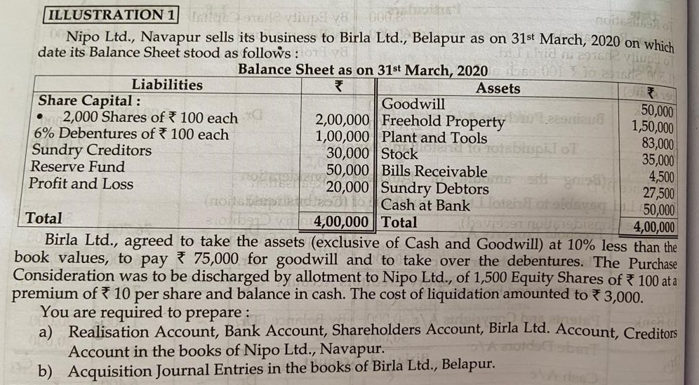
Illustration 1

